Slide 1
Multitasking on Microcontrollers
March 7, 2026

Slide 2
“Round Robin”
Cooperative Multitasking
Task 1
Task 2
Task 3
4

Slide 3
“Pre-emptive” Multitasking
Higher Priority ->
4
3
3
2
1
1

Slide 4
Parallel Processing
Core 1
Core 2
3
4
3
1
2
1

Slide 5
Trade-Offs?
Round Robin
Pre-Emptive
Parallel
Parallel: Mutex, Semaphore, Atomic Operation, Spinlock
Task 1
Task 2
Task 3
4
4
3
3
2
1
1
Core 1
3
4
3
Core 2
1
2
1

Slide 6
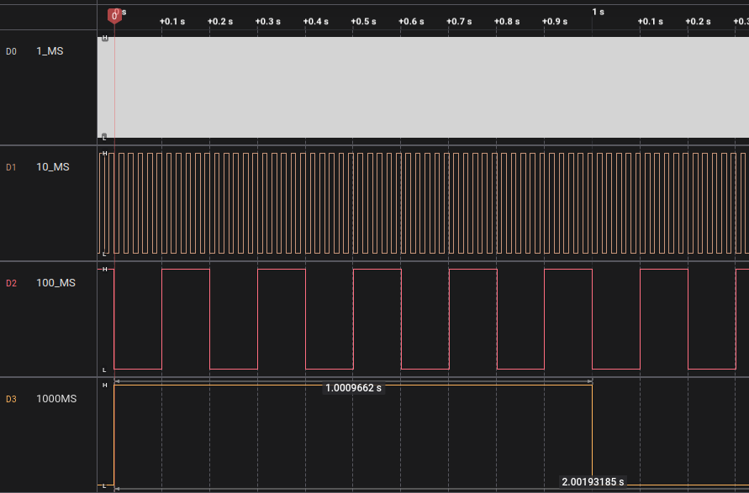
MT1.ino: Round Robin Example
1 second = 1.009662 seconds

Slide 7
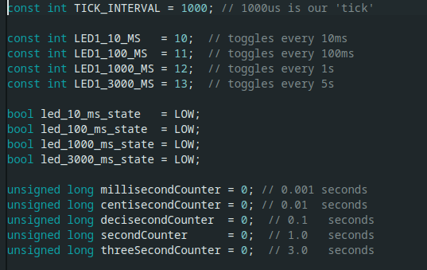
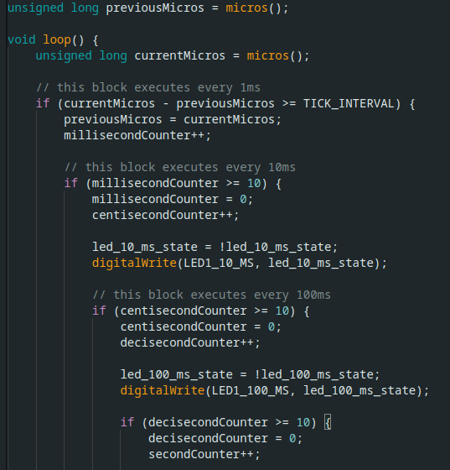
MT1 Code

Slide 8
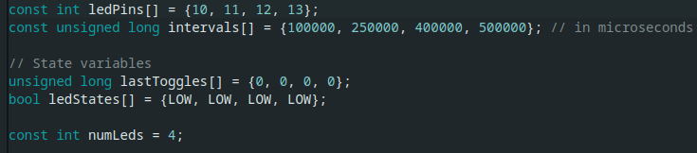
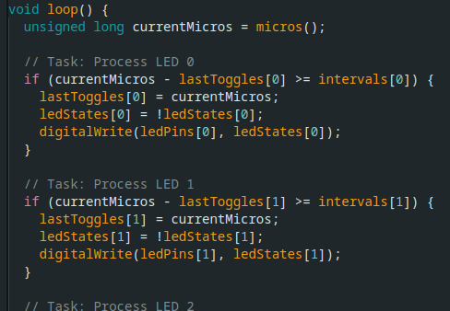
MT2.ino: Multirate Blinker

Slide 9
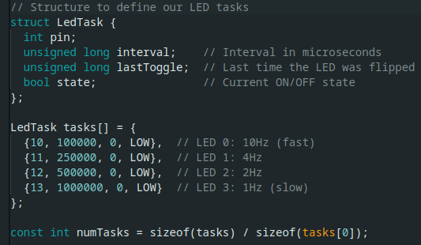
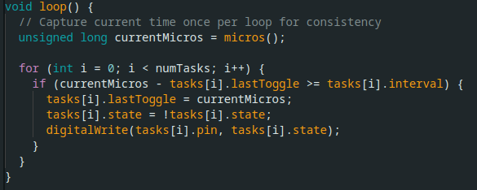
MT3.ino: Using struct tasks

Slide 10
MT4.ino: State Machine
State 1
Off
State 2
On
State 1
Init
State 2
On
State 3
Shutdown

Slide 11
MT4.ino: State Machines
This is a very powerful cooperative multitasking technique for intermediate coders
Go from “writing a story” to “drawing a map”
Pillars of FSM:
- States
- Events
- Transitions

Slide 12
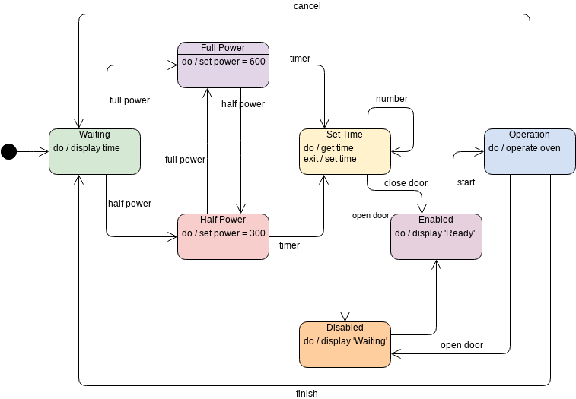
MT4.ino: Microwave Oven
State Machine

Slide 13


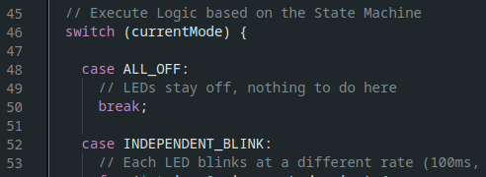
MT4.ino: LED State Machine
State 1
Off
State 2
Blink
State 3
Chase

Slide 14
MT4.ino: LED State Machine
Class exercise:
Can you add a state where all LEDs are lit all the time?

Slide 15
MT5.ino: Capture Keyboard
loop()
Keyboard Check()
State Machine
Keyboard Check()
Capture char
If command → update

Slide 16
MT6.ino: Mediocre Button Press
Counter
Btn Press Sequence | counter | binary
Initialized | 0 | 0001
#1 | 1 | 0010
#2 | 2 | 0011
#3 | 3 | 0100
#4 | 4 | 0101
#5 | 5 | 0110
#6 | 6 | 0111
#7 | 7 | 1000
… #15 | 15 | 1111
#16 | 0 | 0000

Slide 17
MT6.ino: Mediocre Button Press
Counter
BTN 1
BTN 2
Button Checks
Idle
Move Motor
Idle

Slide 18
MT6.ino: Mediocre Button Press
Counter
Button Presses
Button Checks
Hint: Use hardware interrupt!
4
Idle
4
Idle
4
Idle

